Slide 1

Census Data to Predict Income Brackets

Slide 2
Introduction
We will today have a look at the data extracted from the 1994 Census Bureau database, and try to find insights about how different features have an impact on the income of an individual. By analysing key demographic and economic factors, we aim to uncover patterns and trends that can inform strategies to reduce income inequality.
The above introduction had an aim to increase awareness about how the income factor actually has an impact not only on the personal lives of people but also an impact on the nation and its betterment.

Slide 3
Objective
The objective of this presentation is to demonstrate how machine learning can be harnessed to predict income brackets based on demographic and occupational data. We will explore the impact of various factors—such as education, occupation, and work hours—on income levels and highlight how these insights can be used to develop targeted policies. Our analysis seeks not only to predict income but also to understand the underlying drivers of income inequality, offering a data-driven approach to economic and social decision-making.

Slide 4
About Dataset
The dataset used in this analysis comes from the 1994 Census Bureau and contains detailed information about individuals from various demographic backgrounds. The dataset includes 32,537 records and 14 features that capture various aspects of a person’s life, such as their age, education, occupation, and work hours. These features are used to predict whether an individual's income is above or below $50,000 per year.

Slide 5
Features Information
Age: The age of the individual.
Work-class: The employment type (e.g., Private, Self-emp-not-incorporate, etc.).
Final weight: The weight assigned to the combination of features (an estimate of how many people belong to this set of combinations)
Education: The highest level of education achieved.
Education-num: Number of years of education.( Preschool=1, 1st-4th =2, 5th-6th=3, 7th-8th=4 etc)
Marital status: Marital status (e.g., Married-civ-spouse, Never-married, etc.).
Occupation: Job type.
Relationship: Family relationship status (e.g., Husband, Not-in-family, etc.).
Race: Race of the individual.
Sex: Gender of the individual.
Capital-gain: Capital gains.
Capital-loss: Capital losses.
Hours per week: Hours worked per week.
Native country: Country of origin.

Slide 6
Income Categories
The target variable divides individuals into two income groups :
1. Individuals earning $50,000 or less per year.
2. Individuals earning more than $50,000 per year.

Slide 7
Steps involved in this project
Importing the Libraries
Importing the Dataset
Exploratory Data Analysis
Feature Engineering
Feature Scaling
Label Encoding
Model Selection
Confusion Matrix
Model Evaluation
Model Deployment

Slide 8
INSIGHTS

Slide 9
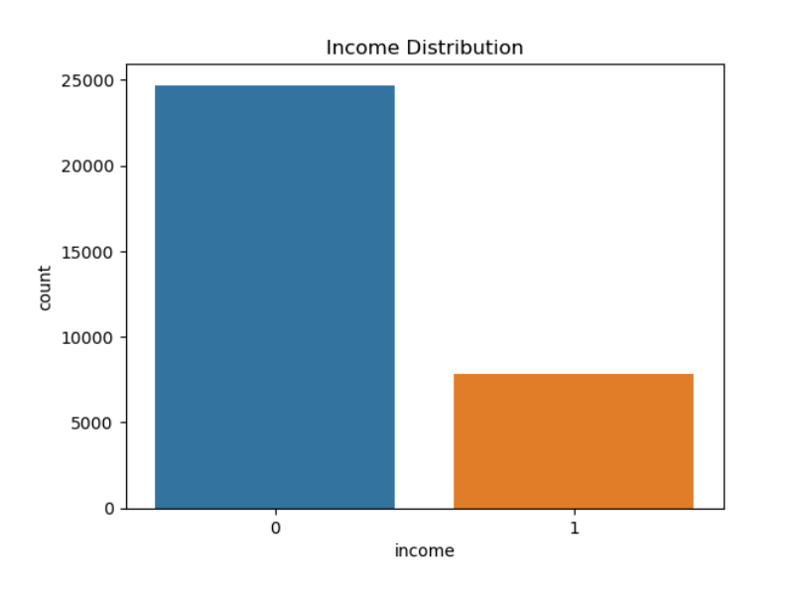
Income Distribution
Here we can see that an income of less than 50k dollars is almost 76% in the given data i.e. 24,698 and an income of more than $50k is just 24% i.e. 7,839, so we can state that the given data should be slightly imbalanced

Slide 10
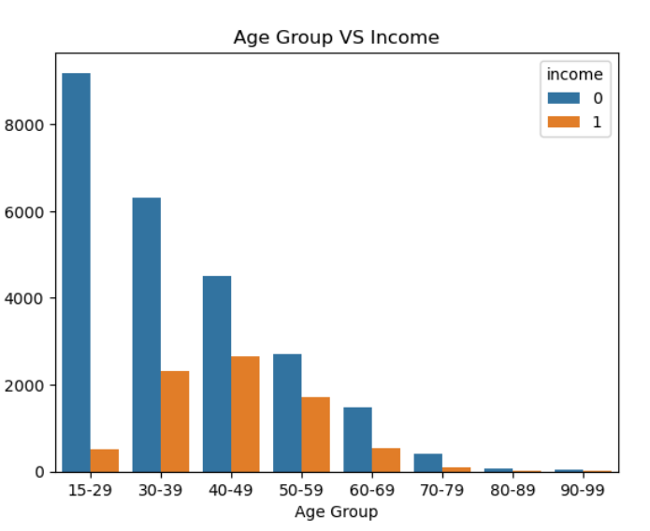
By looking at this graph we can conclude that the Age group 15-30 have the highest number of people whose earnings are less than 50k dollars per year The Age groups 40-49 and 50-59 have the highest number of people whose earnings are more than $50k per year.

Slide 11
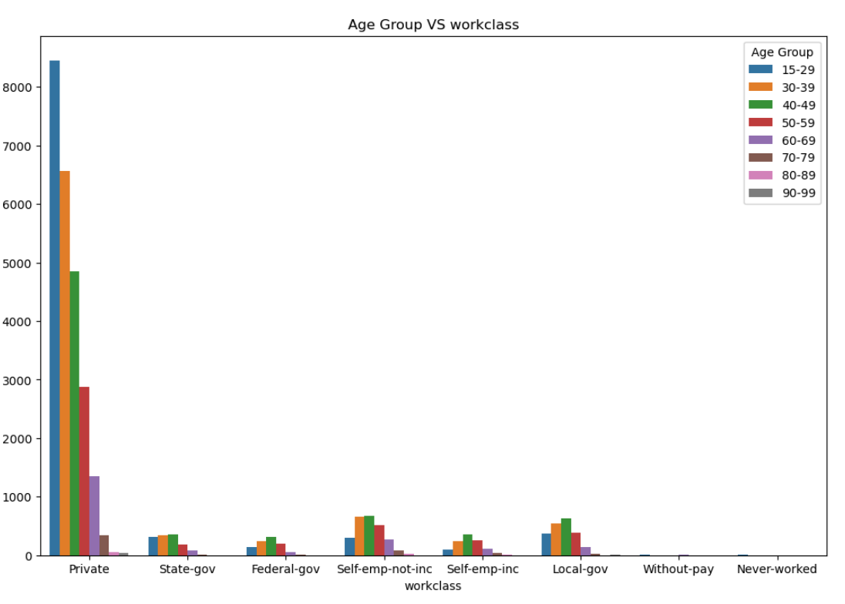
We can see that most people's work class is Private in all Age groups and then self-employment-not-incorporate and local government.

Slide 12
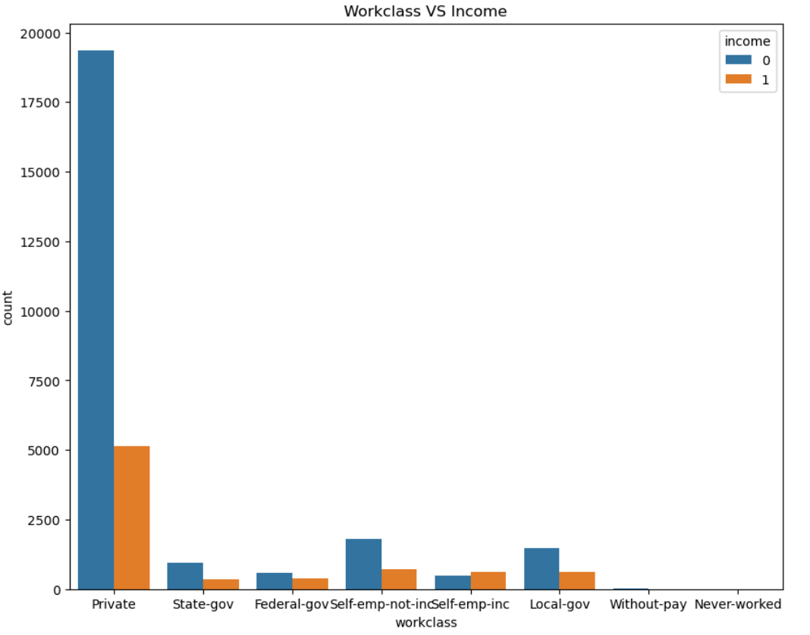
By looking at this graph we can conclude that only in self-emp-incorporated work class people earn more than 50k dollars as compared to people whose earnings are less than 50k dollars per year.

Slide 13
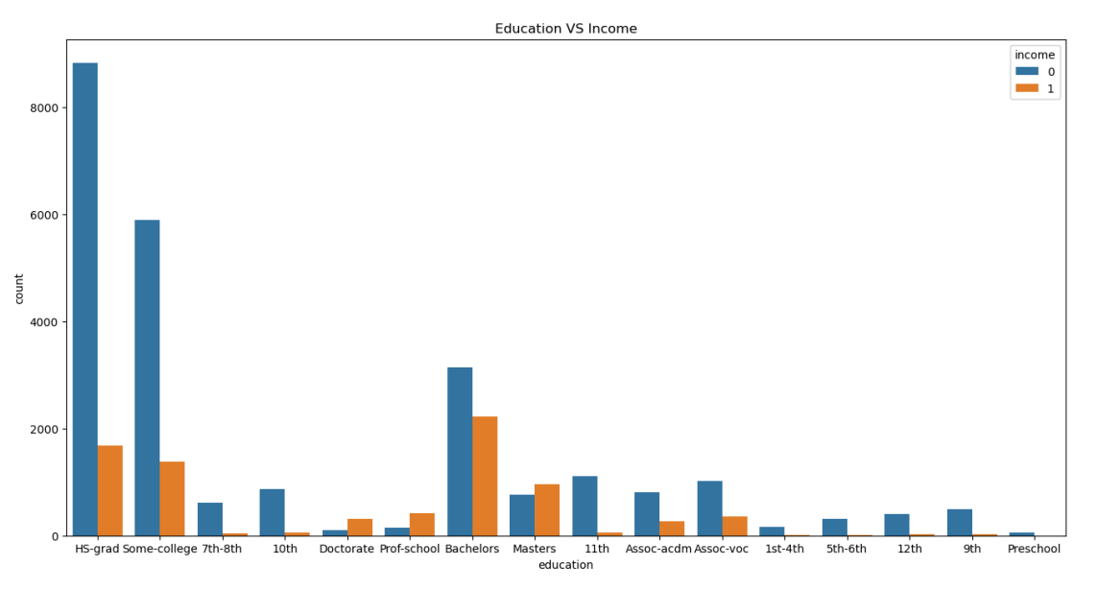
We can see that only Doctorate, Prof-school and Masters have earned more than 50k dollars per year than those who have not earned more than 50k dollars. In other education, more people earn less than 50k dollars than people who earn greater than 50k dollars per year

Slide 14
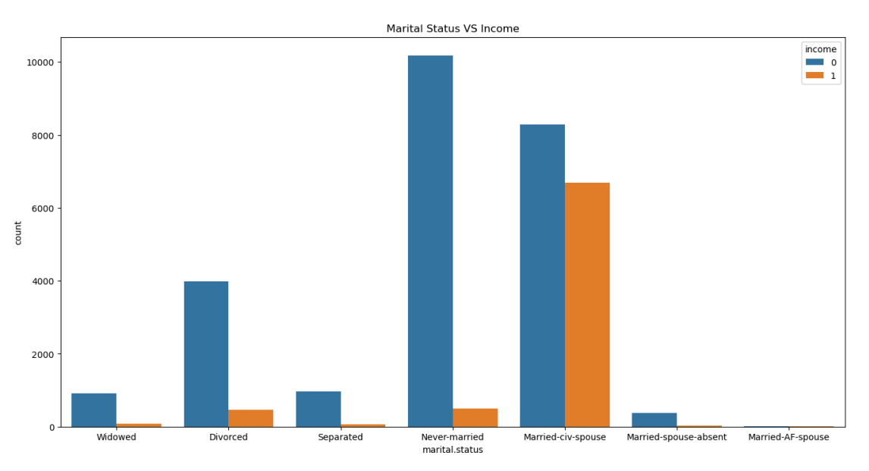
In marital status, we can see that most people who Married Civilian Spouses earn more than 50k dollars per year as compared to other statuses and the least of people who never married. In never married most people earn less than 50k dollars.

Slide 15
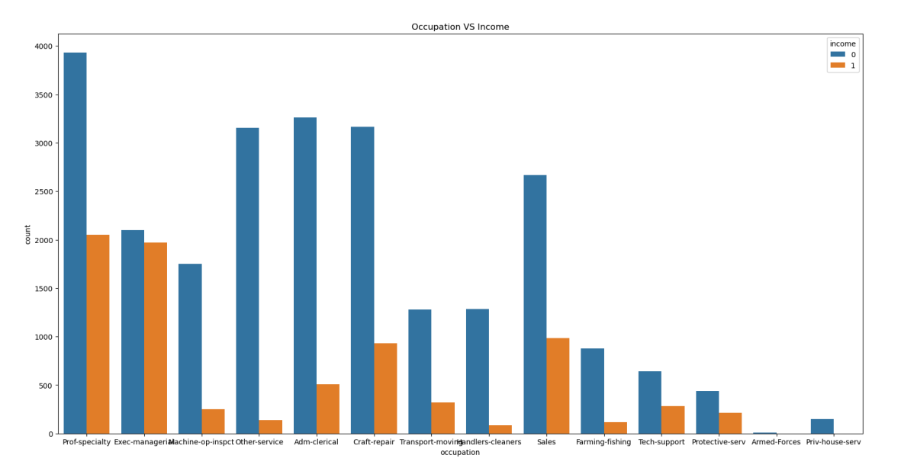
we can see as compared to other occupations Executive and Managerial roles have more people who earn more than 50k dollars per year and very few in the Armed forces.

Slide 16
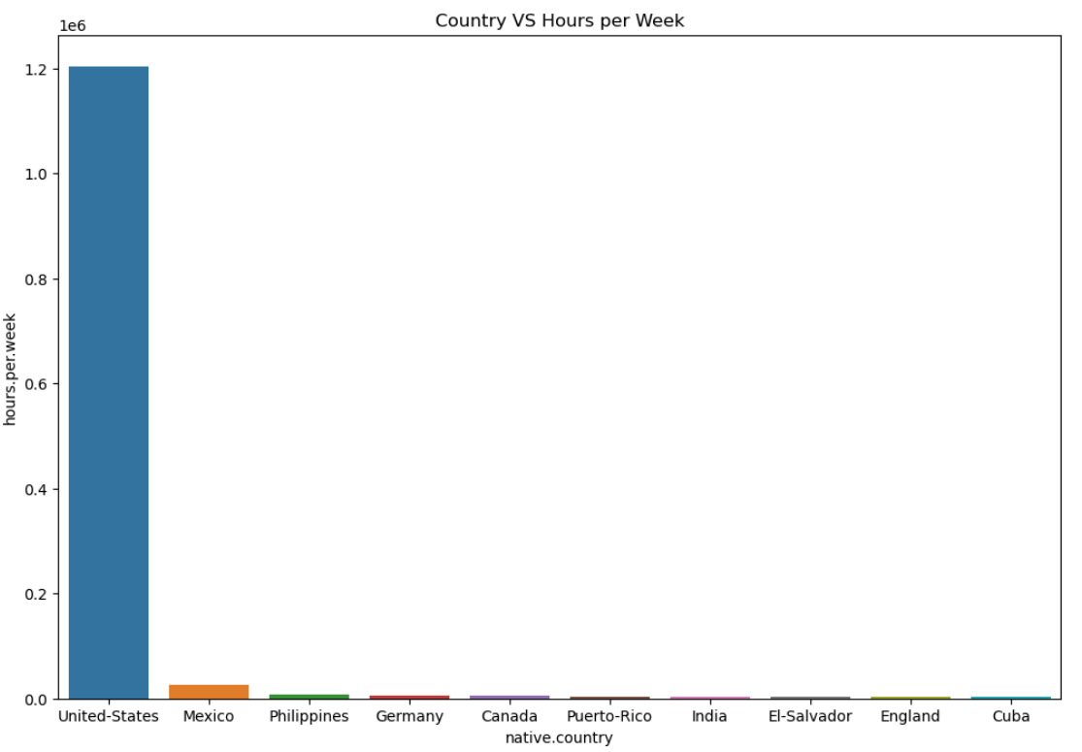
The United States people get more hours as compared to other countries like India, England and Germany etc.

Slide 17
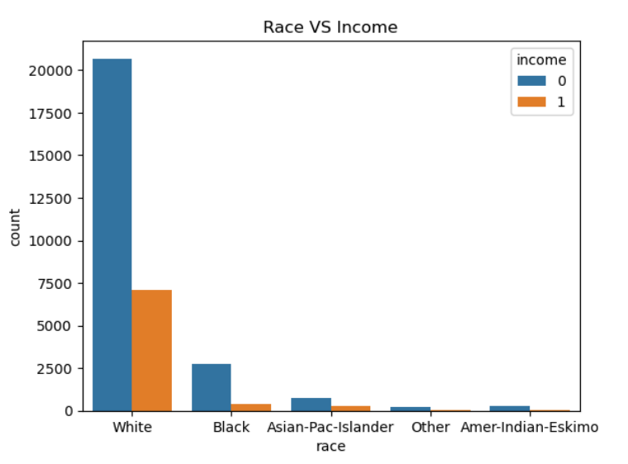
The number of people who earned more than greater than 50k dollars per year are white men as compared to other races.

Slide 18
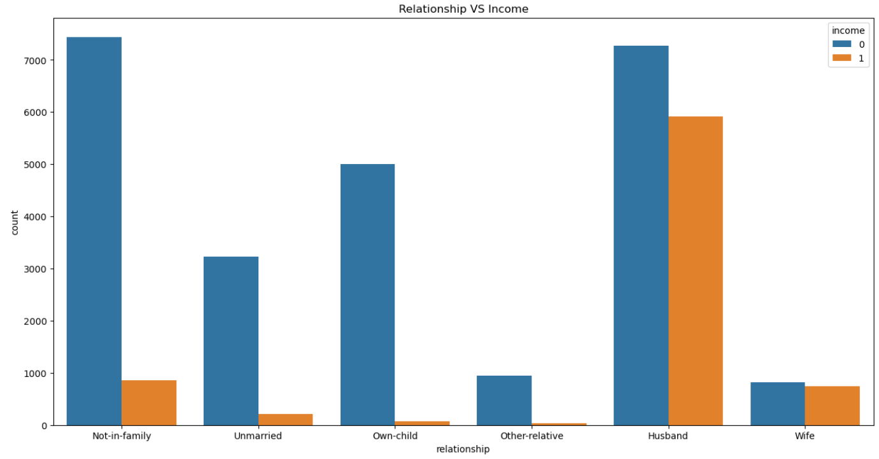
The majority of individuals are categorized as husbands and Wife who earn more than $50K per year. Few of them who is Unmarried and Not-in-family.

Slide 19
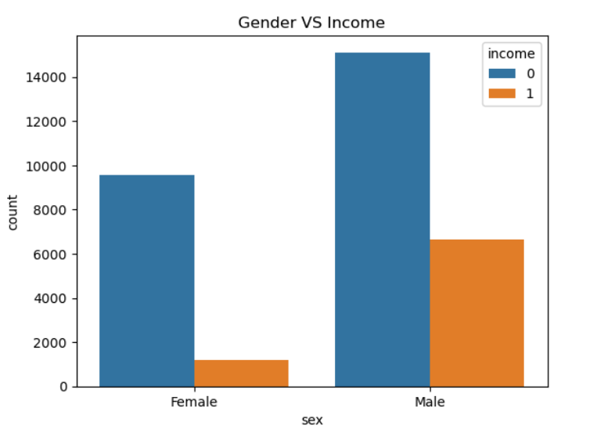
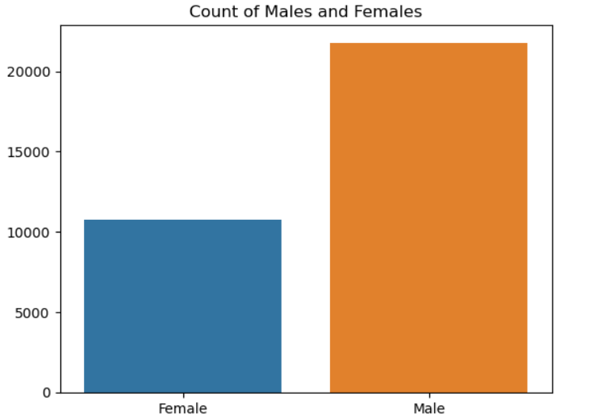
We can see that Male candidates earned more than 50k dollars are more as compared to female candidates.

Slide 20
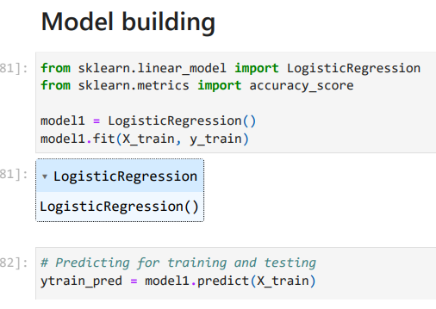
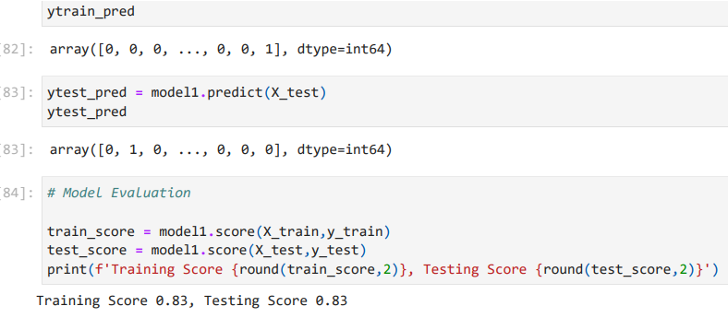
Model Accuracy

Slide 21
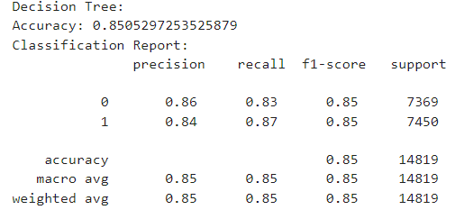
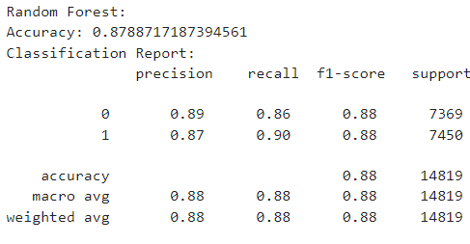
After Applying SMOTE
Decision Tree
Random Forest

Slide 22
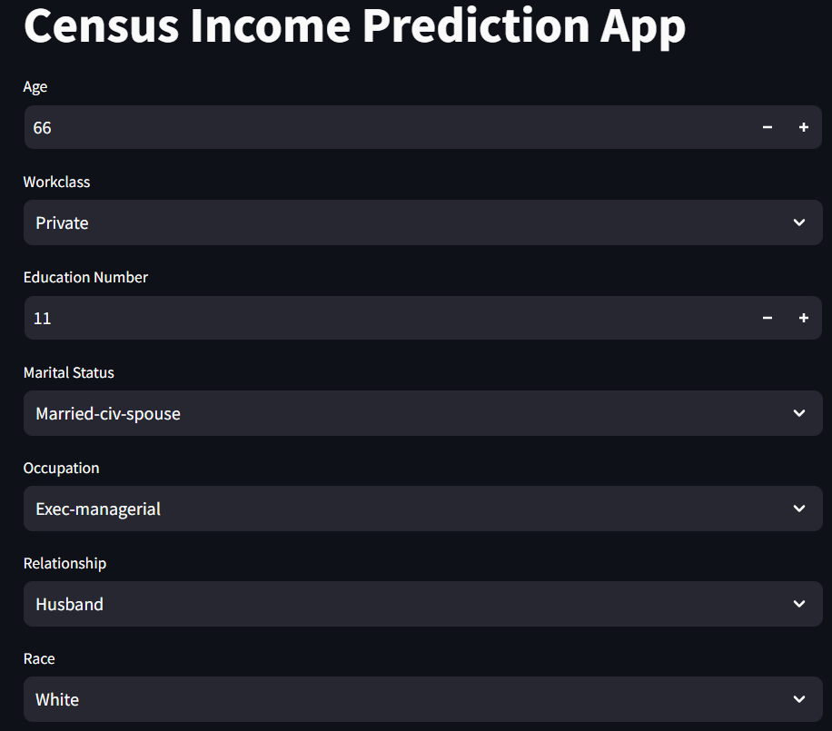
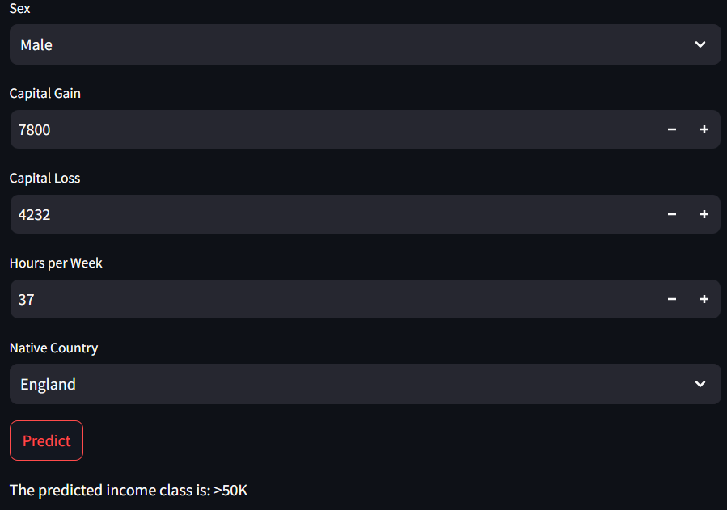
MODEL Deployment

Slide 23
Conclusion and Summary
This project successfully applied machine learning techniques to predict whether an individual's income exceeds $50K per year using the Adult Census Income dataset. Our analysis revealed that factors such as education level, occupation, and hours worked per week are significant predictors of income. Additionally, these factors vary across different demographic groups, influencing income distribution.
Key findings include:
Education: Individuals with higher education levels, particularly those with Doctorate, Professional School, or Master's degrees, are more likely to earn above $50K.
Occupation: Executive and managerial roles are strongly associated with higher income levels, while other occupations, such as those in the armed forces, show lower income brackets.
Work Hours: The number of hours worked per week is a critical factor, especially for individuals over 30, in determining higher income levels.

Slide 24
THANK YOU

